Slide 1
Fraud Detection Using Machine Learning Algorithms
Oyindamola Obisesan
Michael Olubode
Judah Odiachi
Adesoji Akanji

Slide 2
INTRODUCTION
The objective of this work is to predict if a transaction is fraudulent or not.
The dataset used in this analysis is gotten from kaggle and is a simulated dataset.
This work includes both data exploration and modelling.

Slide 3
WORKFLOW
Start
Import Dataset
Clean raw dataset
Exploration
Data visualization
Analyze data; outlier, missing data, min, max
Feature Selection
Analyze the features and select important features.
Create new dataset with new features.
Dataset Balancing
Algorithms
Model Evaluation
Under-sampling, Oversampling and SMOTE
Equal proportion of fraud and non fraud.
Random Forest
Decision Trees
Support Vector Machines (SVM)
Logistics Regression
Recall, precision, F1, kappa score, accuracy.
On train and test dataset.
Conclusion
Best performance model.
Study inferences.
Future improvement.

Slide 4
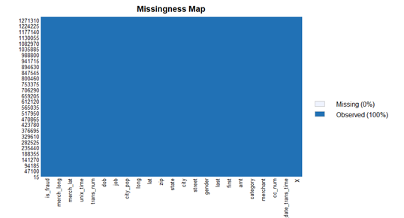
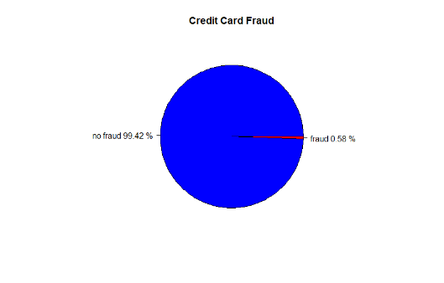
Data Exploration
Exploring Missingness in Data
Exploring balance in dataset
In exploring the missingness of variables in the data, we see that there are no missing variables in the dataset. This is because this is a simulated dataset.
The plot above shows the imbalance in the dataset. There is a high percentage of non-fraudulent activities compared to fraudulent activities showing the need to balance the dataset

Slide 5
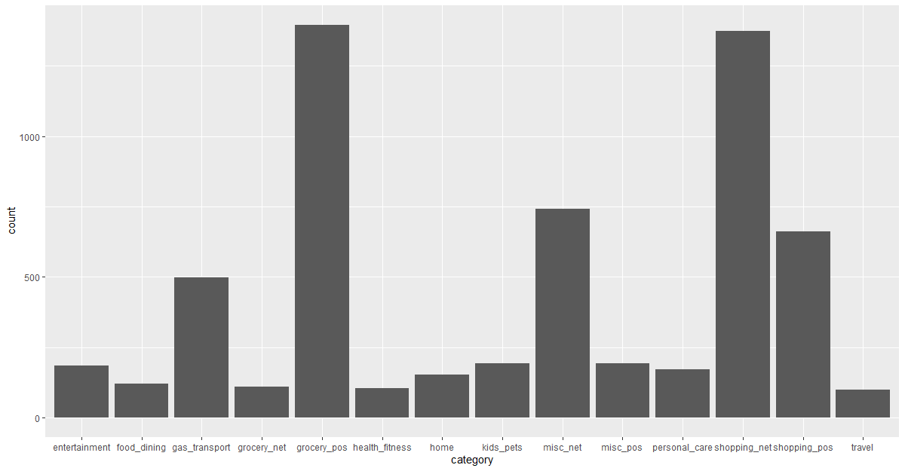
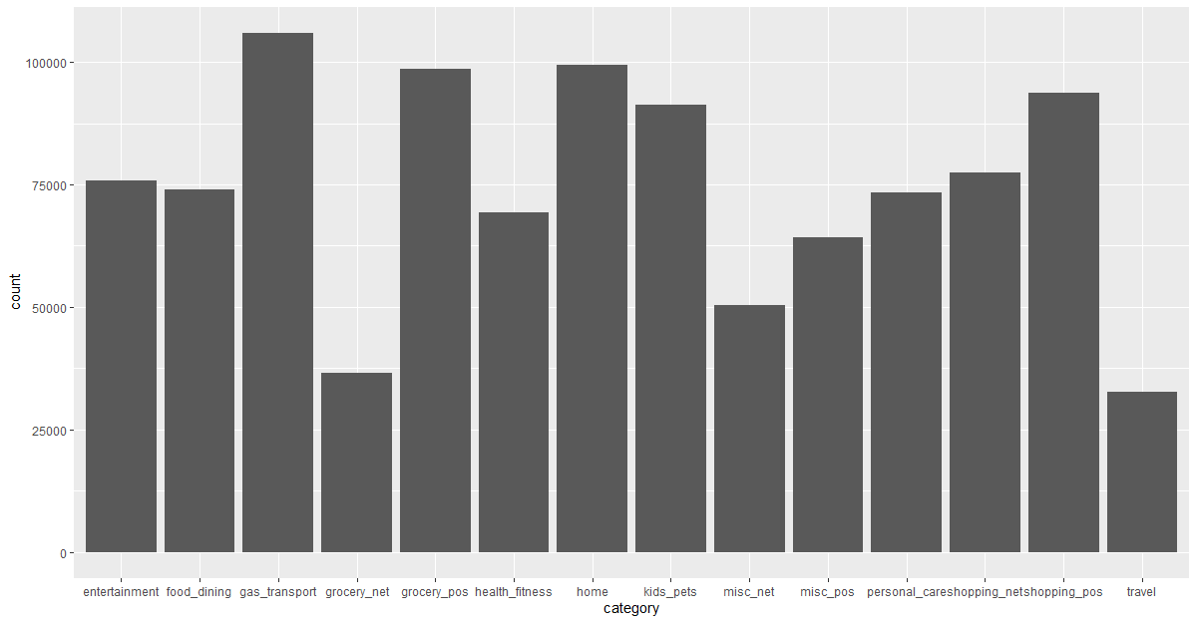
Data Exploration
We explored the dataset to check if specific categories of transactions are specific to fraudulent transactions
Fraudulent Categories
Non-Fraudulent Categories
From the analysis of the results, most fraudulent transactions appear to be related to grocery_pos and shopping_net categories, while the non-fraudulent transactions do not seem to be specific to any category in particular

Slide 6
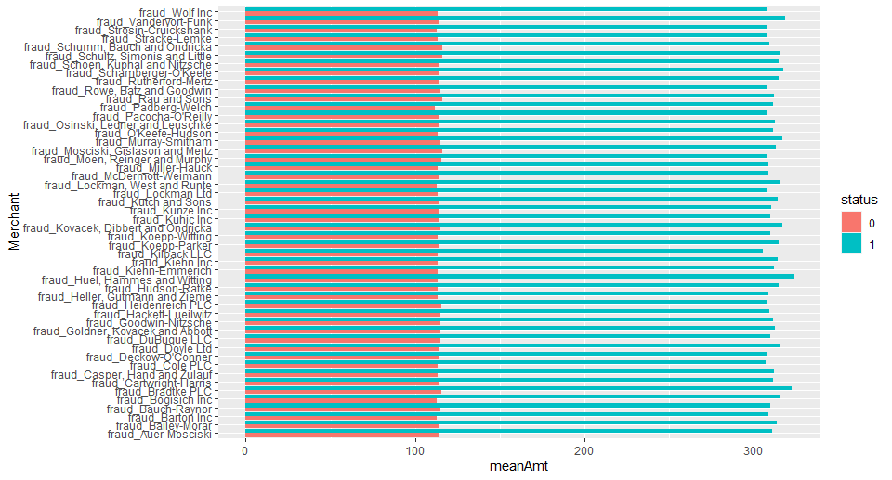
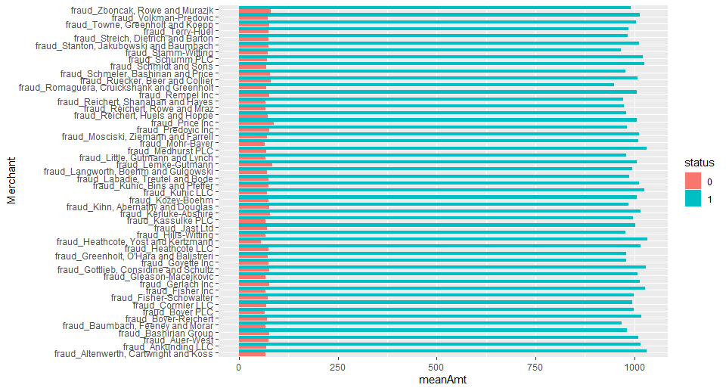
Data Exploration
Comparing amounts of fraud and non-fraud transactions for categories: Grocery_POS and Shopping_Net, and State
Since we could see that Grocery_POS and Shopping_Net were the transactions with the most fraudulent activities:
We decided to delve deeper to see if these activities were specific to certain merchants to enable us easily identify potential fraudulent transactions, by comparing the mean transaction amounts.
From the analysis, the fraudulent transactions are not specific to certain merchants, as it is seen that all merchants have about the same order of fraudulent transaction amounts
Grocery_POS
Shopping_Net

Slide 7
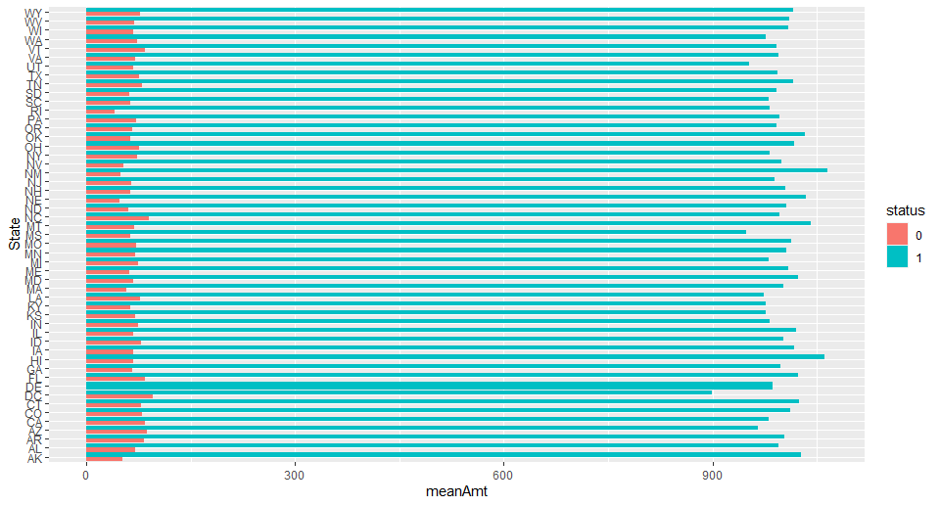
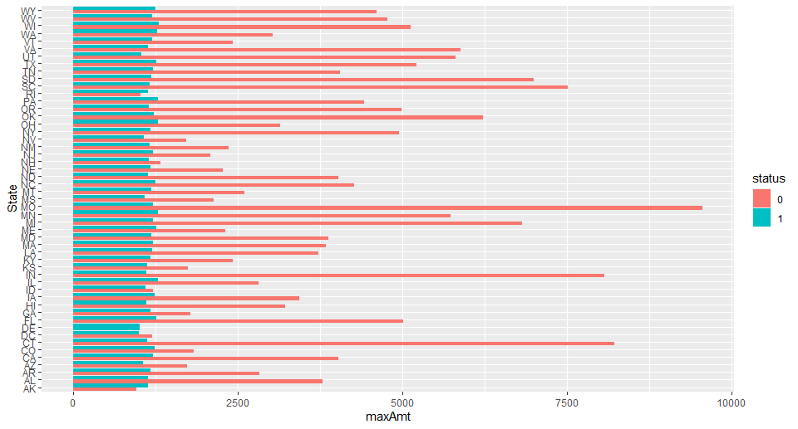
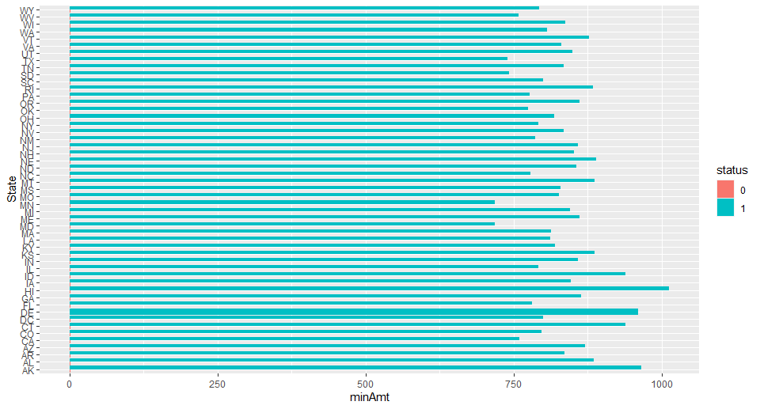
Data Exploration
In the dataset, status “1” refers to fraudulent transactions and “0” refers to non-fraudulent transactions. We explored the mean, maximum and minimum amounts spent in transactions on a state basis.
Mean transaction amount by state
Max. transaction amount by state
Min. transaction amount by state
It is seen that the mean amounts in fraudulent transactions outweigh the non-fraudulent transactions. This gives an idea that taking a mean of the transaction amounts on a statewide basis or individual card holder basis could help in deciphering fraudulent transactions.
Comparing the maximum amount in transactions, the non-fraudulent transactions are greater than fraudulent transactions, showing the fraud perpetrators are smart enough to mask their transactions.
While, the minimum amount in fraudulent transactions are greater than the non-fraudulent transactions, as would be expected

Slide 8
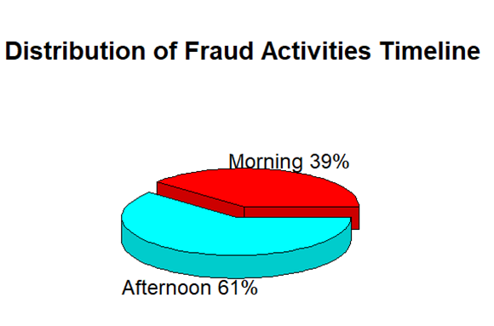
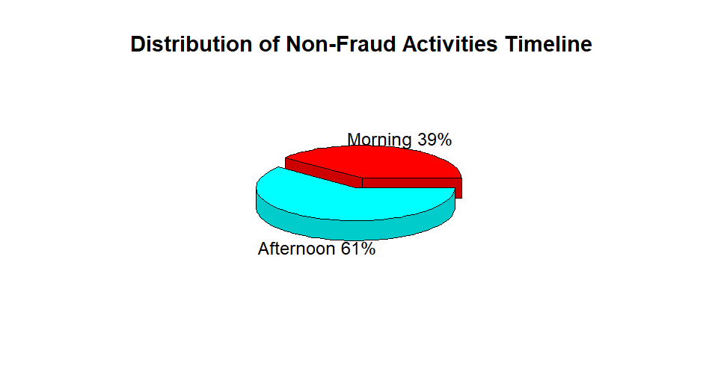
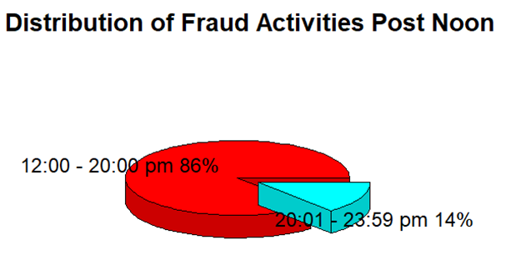

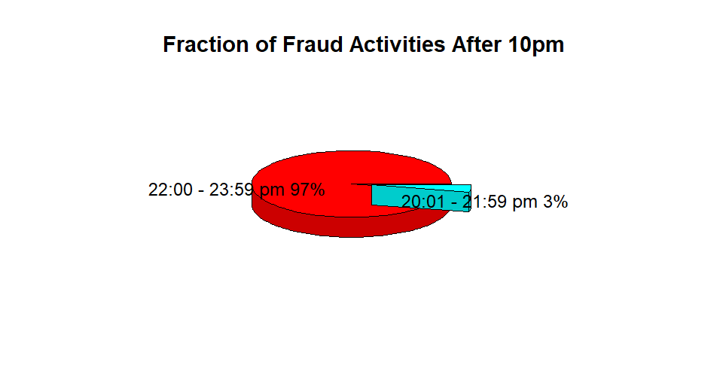
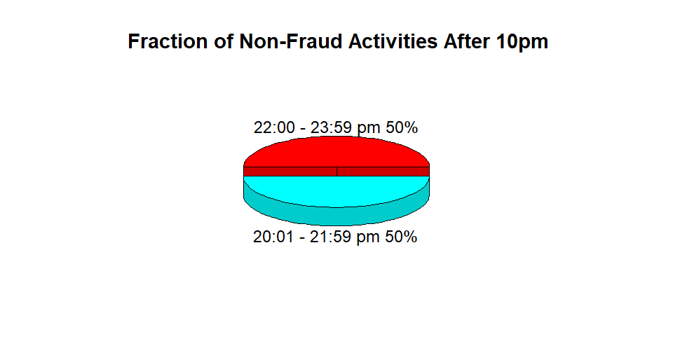
Feature Engineering/Feature Importance
Extracting Transaction Time – Fraud and Non-Fraud Cases
A first glance, we see similarity in transaction trends
A closer look shows higher percentage of fraudulent transactions occur post noon, indicating the importance of time of transaction
97% of the 14% fraud transactions occur between 10 pm – 12 am further confirming the importance of transaction time

Slide 9

Machine Learning Algorithm
Logistic Regression
Random Forest
Support Vector Machines (SVM)
Decision Trees

Slide 10
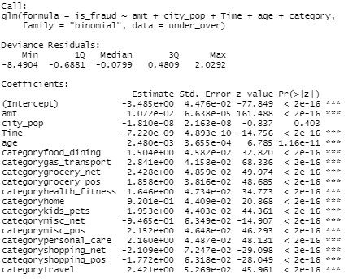
Logistic Regression
We considered several models for this work and logistic regression was also considered due to its effectiveness as a classification model.
Although there are no hyperparameters to tune, an initial model was run to have a feel of the important variables from the resulting p-values
The Estimates of the variables indicate the log of odds of the predictors which is an indication of the effect of a unit change in each predictor while others are kept constant.

Slide 11
Logistic Regression
Two models were built;
one from undersampling the negative case to balance the dataset
The other from oversampling the positive case (fraud) and undersampling the negative case (non-fraud) to obtain a balanced dataset of 200,000 instances from the original 1,300,000 instances
The undersample model has a slightly higher recall while the oversample model has a slightly higher precision on the imbalanced test data.
Both precision values are too low and will surely annoy card users because of the percentage of false positives, >99%.
 |  | Logistic Regression model
 |  | Recall | Precision | Accuracy | Kappa | F1
undersample model | Undersampled data | 0.8674 | 0.7503 | 0.8178 | 0.6356 | 0.804612
 | Imbalanced Train data | 0.9695 | 0.1281 | 0.9695 | 0.2105 | 0.226299
 | Imbalanced Test data | 0.7273 | 0.0708 | 0.9621 | 0.1229 | 0.129039
oversample model | Oversampled data | 0.8814 | 0.751 | 0.8256 | 0.651 | 0.810992
 | Imbalanced Train data | 0.7359 | 0.1324 | 0.9706 | 0.2168 | 0.224423
 | Imbalanced Test data | 0.7254 | 0.0772 | 0.9655 | 0.1335 | 0.139549

Slide 12
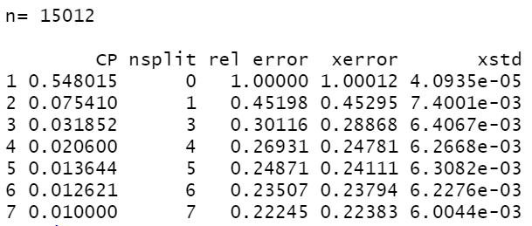
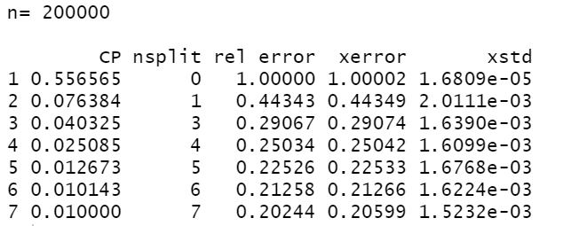
Decision Trees
Since Decision trees models are good at classification, the model was also considered.
Gini index and information gain mostly produce the same results, hence gini and 10-fold CV were used as hyperparameters.
Like the case of logistic regression, two Decision trees models were built. Both on balanced data of 15,012 and 200,000 samples representing undersampling and oversampling respectively.
The optimum number of split which corresponds to the minimum relative error is 7 splits in both cases.
Both trees were pruned to the depth of lowest cost parameters and relative error.

Slide 13
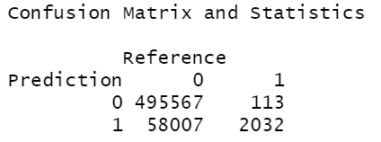
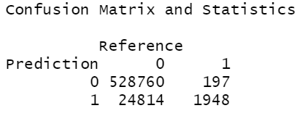
Decision Trees
The resulting models were tested on the whole imbalanced train data and test data with the results presented on the table.
Confusion matrix of the undersample model is above and that of the oversample model is below the table.
Although the undesample model has a higher recall on the test data, the oversampled data reduced the false positives by almost 50% (58,007 to 24,814) which is indicated in the gain on precision.
The Kappa score of the undersample model on the test data also indicates that the model prediction is very close to random chance.
While high recall is desirable in this study, it is important to be consider the credit card users and not frustrate them by excessive false positives which will result in transaction delay.
Although the cost of fraud is high, the cost of flagging and delaying a legitimate transaction could also be very high considering market volatility.
 |  | Decision Tree Model
 |  | Recall | Precision | Accuracy | Kappa | F1
undersample model | Undersampled data | 0.8987 | 0.9572 | 0.9247 | 0.8493 | 0.927028
 | Imbalanced Train data | 0.9572 | 0.0505 | 0.8957 | 0.086 | 0.095938
 | Imbalanced Test data | 0.9473 | 0.0338 | 0.8954 | 0.0583 | 0.065271
oversample model | Oversampled data | 0.9534 | 0.9186 | 0.9371 | 0.8742 | 0.935677
 | Imbalanced Train data | 0.9187 | 0.1064 | 0.9549 | 0.1822 | 0.190712
 | Imbalanced Test data | 0.9082 | 0.07279 | 0.955 | 0.1285 | 0.134778

Slide 14
Random Forest
Random forest is known for high accuracy and outperforming many other models when tuned correctly.
Random forest is also good for selecting important variables. Since it is a greedy algorithm like DT, it splits on the important variables first.
Random forest model was built on 500 trees and by setting mtry, the number of randomly selected variables used to split at each node, to 3 after tuning.

Slide 15
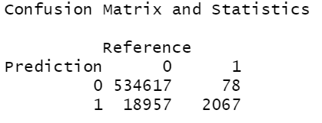
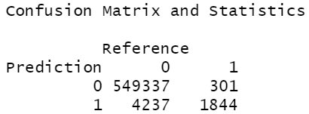
Random Forest
Like the previous models, two models were built, one on the undersampled data and the other on the oversampled data.
The undersample model has a higher recall than the oversample model
It is important to note that the precision of the undersample model is higher than the precisions obtained from the oversample model of logistic regression and decision tree models
The oversample model has a higher improvement on the precision on imbalanced test data while trading the improvement for a loss in recall.
 |  | Random Forest Model
 |  | Recall | Precision | Accuracy | Kappa | F1
undersample model | Undersampled data | 1 | 0.9991 | 0.9995 | 0.9991 | 0.99955
 | Imbalanced Train data | 1 | 0.1533 | 0.968 | 0.2585 | 0.265846
 | Imbalanced Test data | 0.9636 | 0.0983 | 0.9657 | 0.1726 | 0.178401
oversample model | Oversampled data | 1 | 1 | 1 | 1 | 1
 | Imbalanced Train data | 1 | 0.4575 | 0.9931 | 0.6248 | 0.627787
 | Imbalanced Test data | 0.8597 | 0.3032 | 0.9918 | 0.4452 | 0.448295

Slide 16
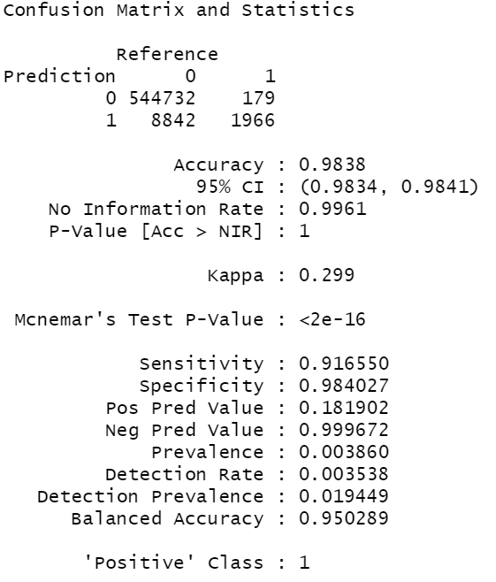
Random Forest
The average of the undersample and oversample produced this result.
The recall and precision values lie between those of undersample and oversample models.
While there is a gain in recall over the oversample model, there is a loss in the values of precision and kappa. It is a tradeoff.

Slide 17
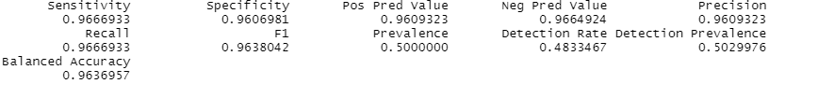

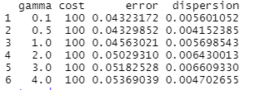
Support Vector Machines (SVM)
The dataset used is the under-sampled data.
The SVM modeled was built with the radial kernel.
The model was optimized with for gamma and C value to determine the level of misclassification in the data.
The gamma value is 0.1 and cost is 100.
The model gave a good value for the precision and recall on the train data.
The precision and recall were very poor on the test data.
Train
Test
Hyper-parameters Optimization

Slide 18
Model Evaluation
The parameters considered are Recall, Precision, F1 Score, Kappa score, Accuracy
The most important metrics is the recall. This is because we are dealing with a fraud data and it is more important the model predicts the maximum number of positive fraud labels.
Random forest gave 0.8597 and a precision of 0.3032.
It is important to maximize recall in our application so as to minimize undetected or eliminate fraud cases nevertheless, we need a trade-off between recall and precision so as not to annoy and lose valuable customers.
The F1 score was 0.4483 and a Kappa score of 0.4452 which shows how far the model prediction is from random chance.

Slide 19
Key Findings
The transaction amount (amt) is the most important feature. The chances of a transaction being fraud does not actually increase with the increase in the amount. Most fraud occur between $500-$1000. This masked behavior was accurately depicted in our model.
The time the transaction occurs is also very important as most of the frauds occur at night after 10pm.

Slide 20
Conclusion
This work can help in flagging fraudulent transactions which are very costly to both organizations and individual customers.
The models can identify virtually all fraudulent transactions in datasets that are highly skewed to normal transactions while reducing false positives.
This is a work in progress and a continuous tweaking of the model would further increase the recall and precision of the model. The availability of more data would further improve model performance.
A higher computational power would permit using more instances to build the models and add more power to the model.

